Slide 1


Session 6
Scams and Magic

Slide 2
Topics for the session
Magic
Scams
Scooby-Do

Slide 3
Magic
“Ninety percent of most magic merely consists of knowing one extra fact.”
Terry Pratchett

Slide 4
Magic
A magician asks you to take a 10p coin out of your pocket but without showing him. You hold it tight in your hand. He tells you the year on the coin. How did he know?
Notes:
It’s likely 1992. The vast majority of 10p coins in the UK were minted in 1992. It’s getting less reliable, but it’s very likely 1992. One extra fact.

Slide 5
Scams
JORDAN: You know how you win at three card Monte?
BILL: How?
JORDAN: Get someone to play.

Slide 6
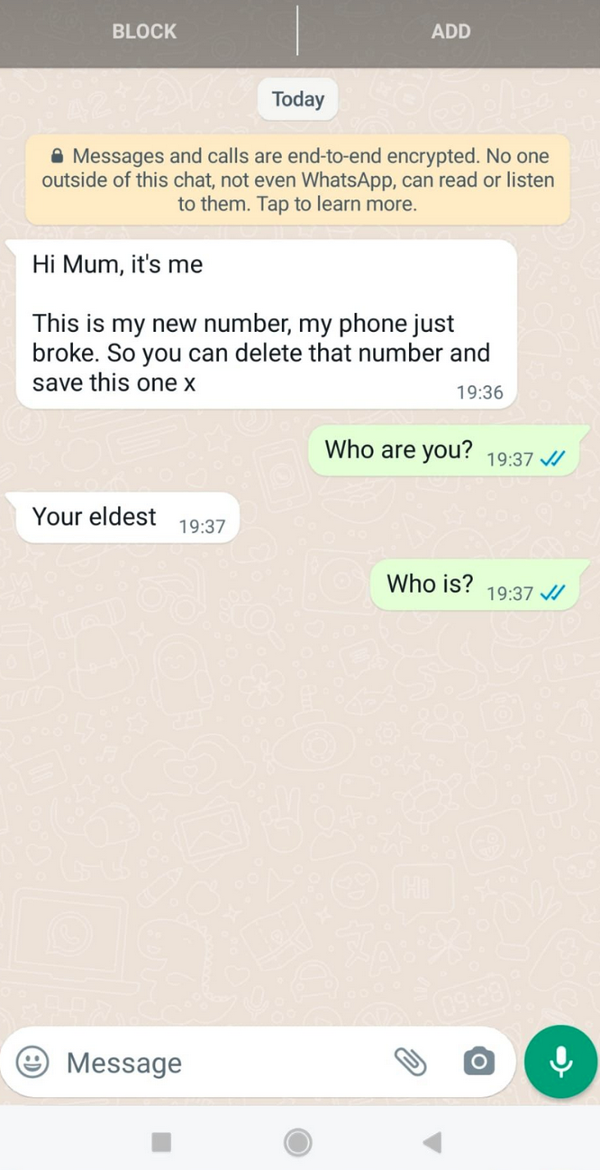
Scams
Note that the encryption is valid, but not helpful here.

Slide 7
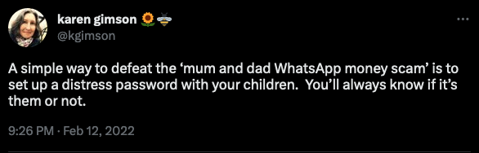
Security Theatre
If your mum needs a password to identify you from a scammer, then something is very wrong really…
“Hi son, just to check, in which fast food chain did you accidentally poop in your pants when you were nine?”
The point here is: just because someone says something confidently, doesn’t mean it’s useful.

Slide 8
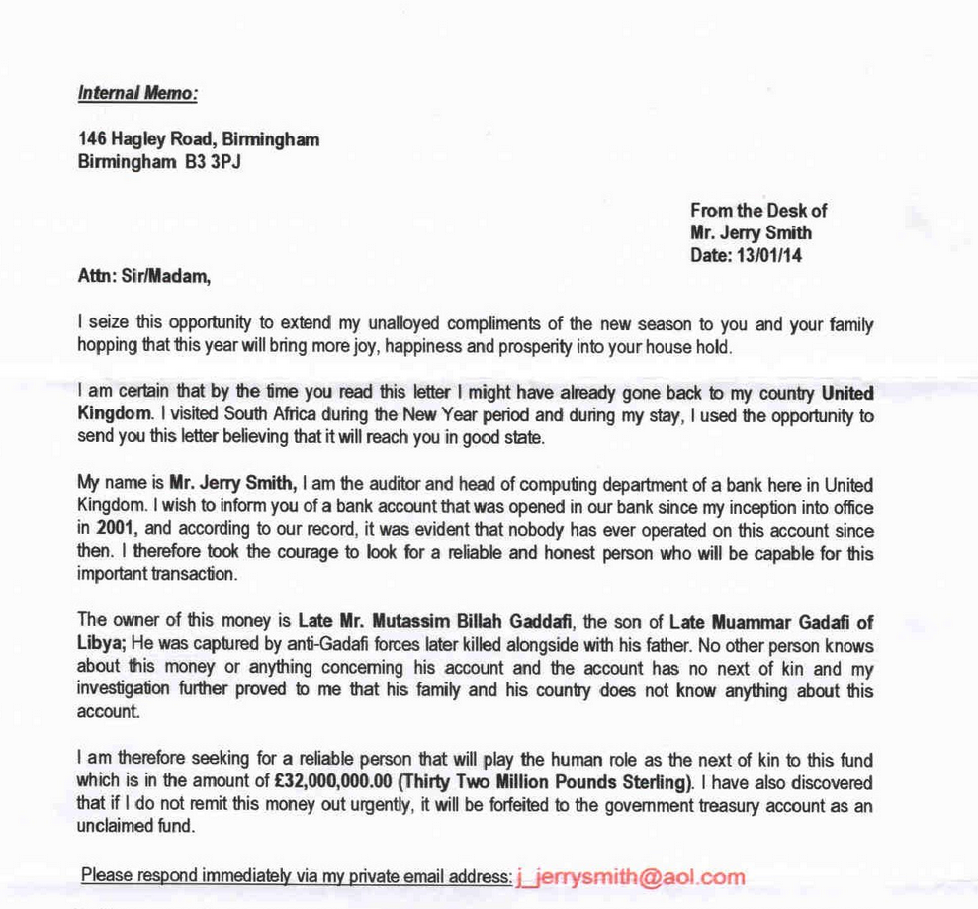
Scam 2
How does the scammer get money out of you?
Why is it so bad? Literally, why don’t they put more effort in?

Slide 9
Scam 2
How does the scammer get money out of you?
Sooner or later you have to send an ‘opening payment’ of £5k. Then someone will need to be bribed. Then a currency exchange.

Slide 10
Scam 2
Why is it so bad? Literally, why don’t they put more effort in?
Because they don’t want normal people to reply - they send millions of these and they only want the really stupid people to reply so they can concentrate on them.

Slide 11
Scam 2
Key thing:
The scammers are asking you do something illegal. That removes a lot of your protection. In general, people asking you to do illegal things are not nice people and are prepared to do illegal things to you.

Slide 12
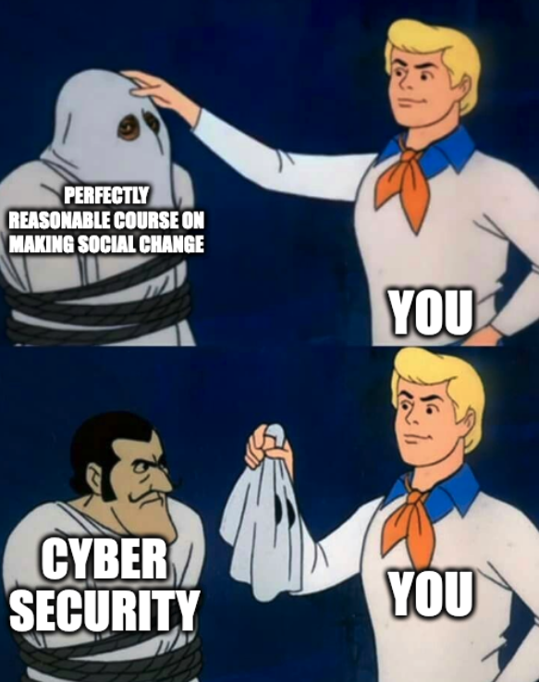

Slide 13
Cyber Security
So yes, you’ve been learning Cyber Security all this time. The course follows CyBOK, which sounds like a Marvel Supervillain, but is actually the national syllabus for learning cyber security.
What we did, was change the examples to ones that are interesting to people who want to make change, instead of examples for people who like things to stay as they are.

Slide 14
Cyber Security
Cyber Security needs people like you. It has contains too many people that want the world to stay as it is.
You can do a lot of good by internalising the principles in this course and taking them with you - but you could also find out more about this stuff by studying Cyber Security more seriously.

